Slide 1
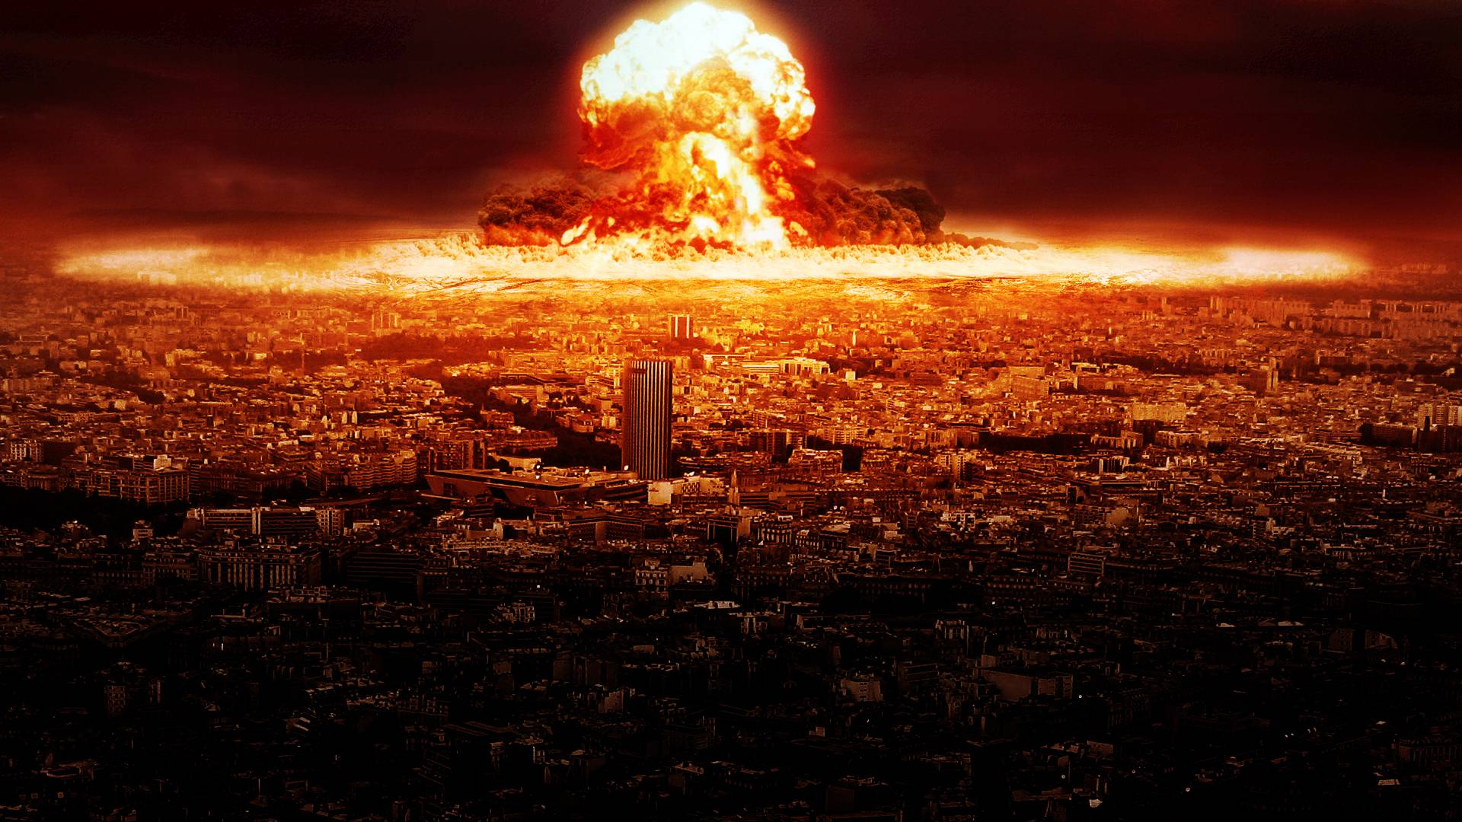


Presented By :-
Akash Ganjegaonkar – 1517
Suraj Yadav – 1548
Whether there will be any terrorist
attack in future ?
be any terrorist attack in future ?
Prashant Karhale
Centre Coordinator
Akshay Tilekar
External Guide

Slide 2
Introduction
Whether there will be any terrorist attack in future ?
Terrorism is, in the broadest sense, the use of intentional violence to achieve political aims. It is used in this regard primarily to refer to violence during peacetime or in the context of war against non-combants(mostly civilians).
The terms "terrorist" and "terrorism" originated during the French Revolution of the late 18th century^{[3]} but gained mainstream popularity in the 1970s during the conflicts of Northern Ireland, the Basque Country and Palestine. The increased use of suicide attacks from the 1980s onwards was typified by the September 11 attacks in New York City and Washington, D.C. in 2001.
Terrorism is a charged term. It is often used with the connotation of something that is "morally wrong"

Slide 3
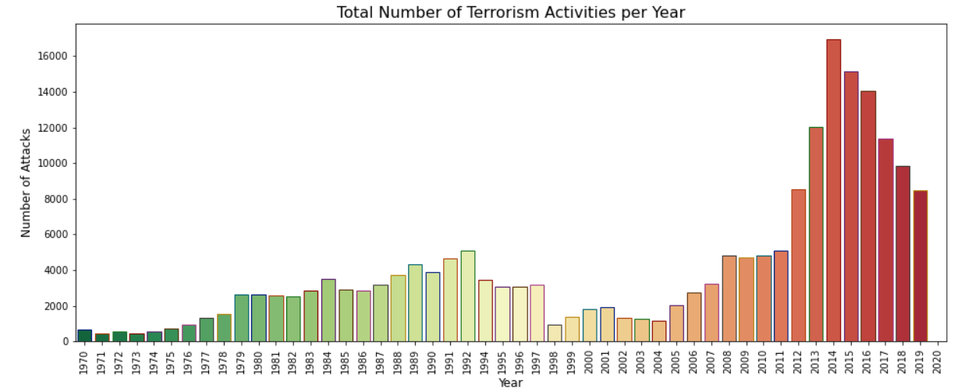
Whether there will be any terrorist attack in future ?
PLANT DISEASE DETECTION USING CONVOLUTION NEURAL NETWORK
Look at the below image for more understanding.
This image is showing the total number of terrorist activities that had been taken place in the period of 1970-2020. As it is clearly visible that the numbers of attacks is increased after 2007 and in 2014 it was the highest , as compared to any other years.
Institute for Advanced Computing and Software Development, Akurdi

Slide 4
So, How to stop this from happening?
Whether there will be any terrorist attack in future ?
PLANT DISEASE DETECTION USING CONVOLUTION NEURAL NETWORK
To overcome such situations in future , we need to increase more security and take maximum safety measures on the places , which were mostly targeted by the perpetrators in the past.
Institute for Advanced Computing and Software Development, Akurdi

Slide 5
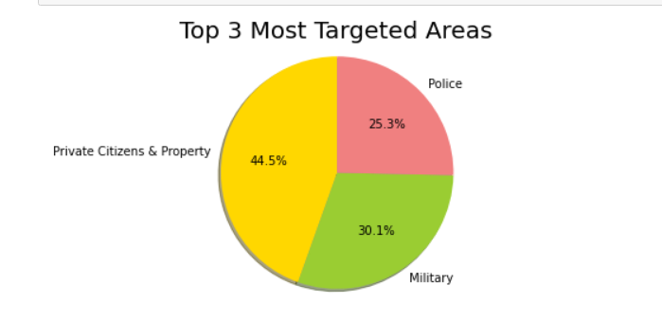
Top 3 Most Targeted Areas
Whether there will be any terrorist attack in future ?
PLANT DISEASE DETECTION USING CONVOLUTION NEURAL NETWORK
In this case , we have use an pie-chart to show which are the
Top 3 most affected areas and where the security measures needs
to be improved.
Most of the attacks in the pasts were taken place on :-
1. PRIVATE CITIZENS & PROPERTY
2. MILITARY
3. POLICE
Institute for Advanced Computing and Software Development, Akurdi

Slide 6
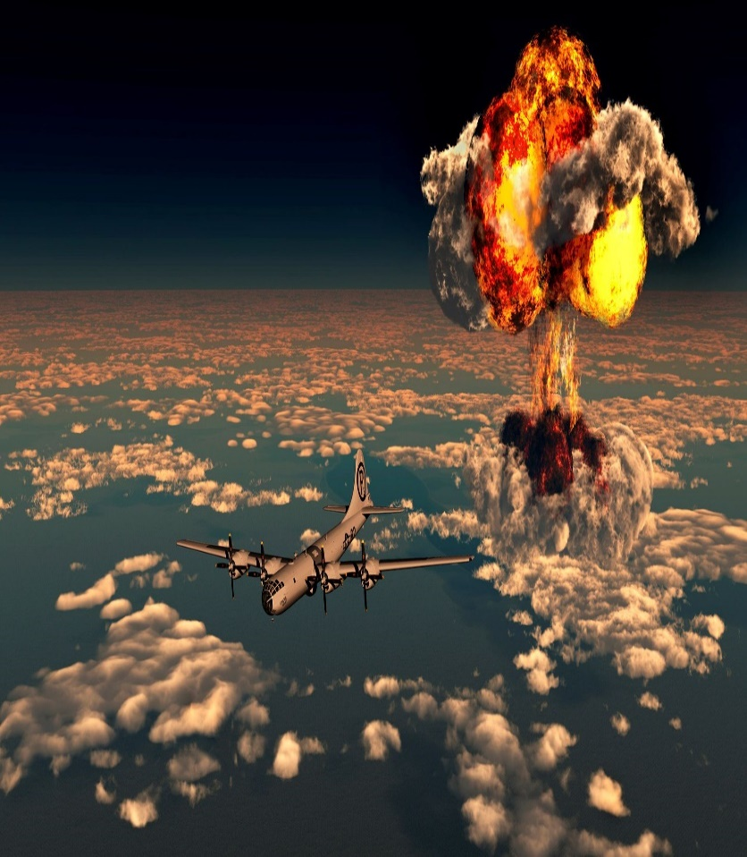
Top 3 Most Preferable Types of Attacks by Perpetrators :-
Whether there will be any terrorist attack in future ?
PLANT DISEASE DETECTION USING CONVOLUTION NEURAL NETWORK
The top 3 general methods of attacks, which are mostly preferable by the perpetrators to spread the chaos are :
1. BOMBING/EXPLOSION :-
An attack where the primary effects
are caused by an energetically unstable
material undergoing rapid decomposition
and releasing a pressure wave that causes
physical damage to the surrounding environment.
Can include either high or low
explosives (including a dirty bomb) but does
not include a nuclear explosive device that
releases energy from fission and/or fusion,
or an incendiary device where decomposition
takes place at a much slower rate.
Institute for Advanced Computing and Software Development, Akurdi

Slide 7

Whether there will be any terrorist attack in future ?
PLANT DISEASE DETECTION USING CONVOLUTION NEURAL NETWORK
2. ASSASSINATION :-
An act whose primary objective
is to kill one or more specific,
prominent individuals.
Usually carried out on persons
of some note, such as
highranking military officers,
government officials, celebrities,
etc.
Institute for Advanced Computing and Software Development, Akurdi

Slide 8

PLANT DISEASE DETECTION USING CONVOLUTION NEURAL NETWORK
Whether there will be any terrorist attack in future ?
3. ARMED ASSAULT :-
An attack whose primary objective
Is to cause physical harm or death
directly to human beings by use of a
firearm, incendiary, or sharp
instrument (knife, etc.).
Also includes attacks involving
certain classes of explosive like
grenades, projectiles, and unknown
or other explosive devices that are
thrown.
Institute for Advanced Computing and Software Development, Akurdi

Slide 9
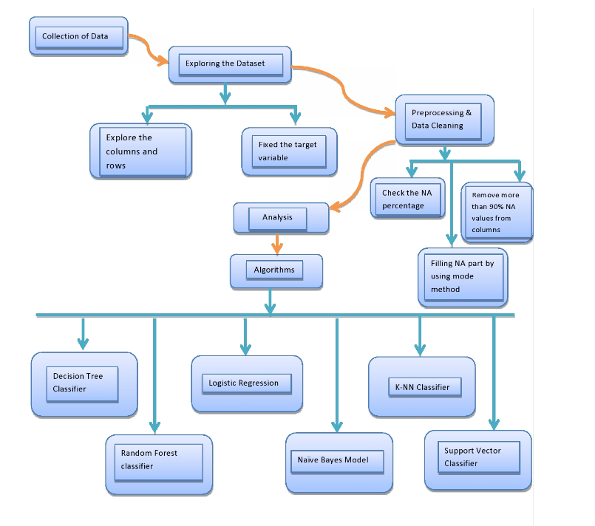
The Good Flow :-
Whether there will be any terrorist attack in future ?
PLANT DISEASE DETECTION USING CONVOLUTION NEURAL NETWORK

Slide 10
Algorithms :-
PLANT DISEASE DETECTION USING CONVOLUTION NEURAL NETWORK
Whether there will be any terrorist attack in future ?
After performing the data-preprocessing and data-cleaning part , now we have used various ML algorithms to train the model and make satisfactory predictions based on the trained data.
The algorithms which we have used are :-
Decision Tree Classifier
Random Forest Classifier
Gaussian Naïve Bayes
Support Vector Classifier(SVC)
K-Nearest Neighbours

Slide 11
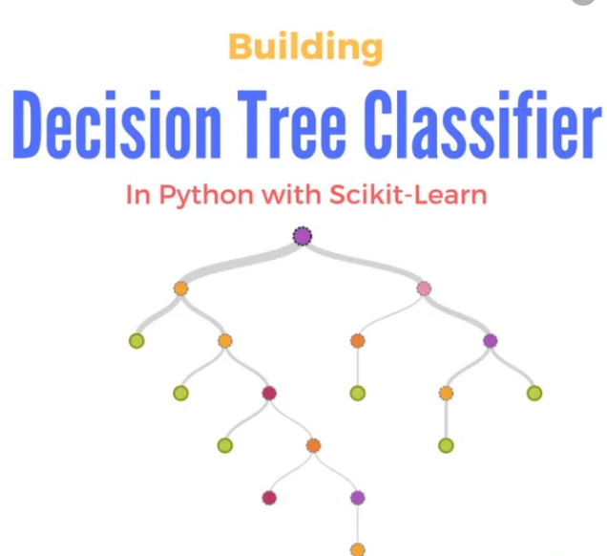
1. Decision Tree Classifier :-
Whether there will be any terrorist attack in future ?
PLANT DISEASE DETECTION USING CONVOLUTION NEURAL NETWORK
Decision Trees (DTs) are a non-parametric supervised learning method used for classification and regression.
The goal is to create a model that predicts the value of a target variable by learning simple decision rules inferred from the data features. A tree can be seen as a piecewise constant approximation.

Slide 12
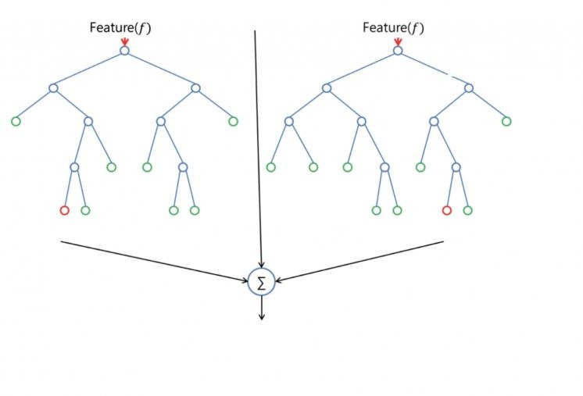
2. Random Forest Classifier :-
Whether there will be any terrorist attack in future ?
PLANT DISEASE DETECTION USING CONVOLUTION NEURAL NETWORK
Random forest is an supervised machine learning algorithm. The "forest" it builds, is an ensemble of decision trees, usually trained with the “bagging” method.
The general idea of the bagging method is that a combination of learning models increases the overall result.
Put simply: random forest builds multiple decision trees and merges them together to get a more accurate and stable prediction.

Slide 13
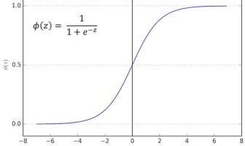
Whether there will be any terrorist attack in future ?
PLANT DISEASE DETECTION USING CONVOLUTION NEURAL NETWORK
3. Logistic Regression :-
Logistic regression is the appropriate regression analysis to conduct when the dependent variable is dichotomous (binary) as well as multi-class. And in case of multi-class , we need to use the concept of “one vs rest”.
Logistic regression is used to describe data and to explain the relationship between one dependent binary variable and one or more nominal, ordinal, interval or ratio-level independent variables.

Slide 14
4. Naïve Bayes :-
Whether there will be any terrorist attack in future ?
PLANT DISEASE DETECTION USING CONVOLUTION NEURAL NETWORK
Naive Bayes is a kind of classifier which uses the Bayes Theorem.
It predicts membership probabilities for each class such as the probability that given record or data point belongs to a particular class.
The class with the highest probability is considered as the most likely class.
The Naïve Bayes theorem is further classified into four parts :-
Gaussian Naïve Bayes
Multinomial Naïve Bayes
Complement Naïve Bayes
Bernoulli Naïve Bayes

Slide 15
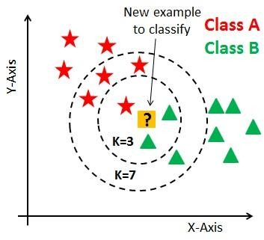
5. K-nearest neighbour :-
Whether there will be any terrorist attack in future ?
PLANT DISEASE DETECTION USING CONVOLUTION NEURAL NETWORK
K nearest neighbor algorithm is very simple. It works based on minimum distance from the query instance to the training samples to determine the K-nearest neighbors. The data for KNN algorithm consist of several multivariate attributes name that will be used to classify.
‘k' in KNN is a parameter that refers to the number of nearest neighbors to include in the majority of the voting process.

Slide 16
6. Support Vector Classifier :-
Whether there will be any terrorist attack in future ?
PLANT DISEASE DETECTION USING CONVOLUTION NEURAL NETWORK
The objective of a Linear SVC (Support Vector Classifier) is to fit to the data you provide, returning a "best fit" hyperplane that divides, or categorizes, your data.
From there, after getting the hyperplane, you can then feed some features to your classifier to see what the "predicted" class is. This makes this specific algorithm rather suitable for our uses, though you can use this for many situations.
SVM offers very high accuracy compared to other classifiers such as logistic regression, and decision trees.
It is used in a variety of applications such as face detection, intrusion detection, classification of emails, news articles and web pages, classification of genes, and handwriting recognition.

Slide 17
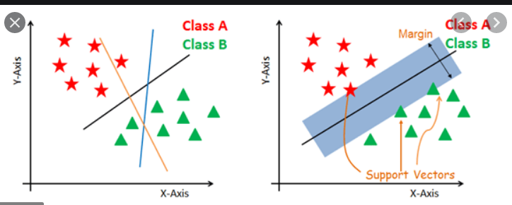
Fig.:- Graphical Representation of SVC
Whether there will be any terrorist attack in future ?

Slide 18
Conclusion :-
Whether there will be any terrorist attack in future ?
PLANT DISEASE DETECTION USING CONVOLUTION NEURAL NETWORK
This system has utilized various ML algorithms to learn and train on the basis of past data.
And , out of these several algorithms “Random Forest“ is providing the best overall accuracy as compared to any other algorithms.
It is concluded from accuracy that “Random Forest“ is highly suitable to predict the possibilities of terrorist attacks in the future.

Slide 19
Whether there will be any terrorist attack in future ?
PLANT DISEASE DETECTION USING CONVOLUTION NEURAL NETWORK
Thank You !!

